Slide 1
Part I Syllabus – Fundamental Underlying Layers
Week​ | Date​ | Subject​
Week 1 | 9/Jan/2023​ | Introduction: Course Logistics and Internet History​
 | 11/Jan/2023​ | Layered Network Architecture​
Week 2 | 16/Jan/2023​ | Physical-layer Resilience
 | 18/Jan/2023​ | Data Link Layer: Flow Control​
Week 3 | 25/Jan/2023​ (no class on 23/Jan/2023, a holiday​) | Data Link Layer: Error Control​
Week 4 | 30/Jan/2023​ | Local Area Network: Introduction​
 | 01/Feb/2023​ | Local Area Network: Medium Access Control (MAC)​
Week 5 | 06/Feb/2023​ | Local Area Network: Ethernet​
 | 08/Feb/2023​ | Local Area Network: Ethernet Evolutions​
Week 6 | 13/Feb/2023​ | Wireless Local Area Network (WLAN): Overview and 802.11
 | 15/Feb/2023​ | First Part: WLAN’s Multi-Access Reservation Protocol (MARP); Second Part: A Brief Overview of Network Paradigms​
Week 7 | 20/Feb/2023 | Network Paradigms​: Circuit Switching versus Packet Switching
 | 22/Feb/2023 | Mobile Access Networks

Slide 2
Additional Materials
The related content talked today in https://eclass.teicrete.gr/modules/document/file.php/TP326/%CE%98%CE%B5%CF%89%CF%81%CE%AF%CE%B1%20(Lectures)/Computer_Networking_A_Top-Down_Approach.pdf is as follow:
WiFi: 802.11 Wireless LANs: Page 526 – Page 546
Cellular Internet Access: Page 547 – Page 555
Mobility Management: Principles: Page 555 – Page 564
You can also find other video materials about
802.11 WiFI https://www.youtube.com/watch?v=t3FVP5wuG4g
Wireless Communication https://www.youtube.com/watch?v=8T7orRAQgic&list=PLCyR4nKNLRkFTER9ohRBnbRFK0pWe0Qtf&index=1&t=61s

Slide 3
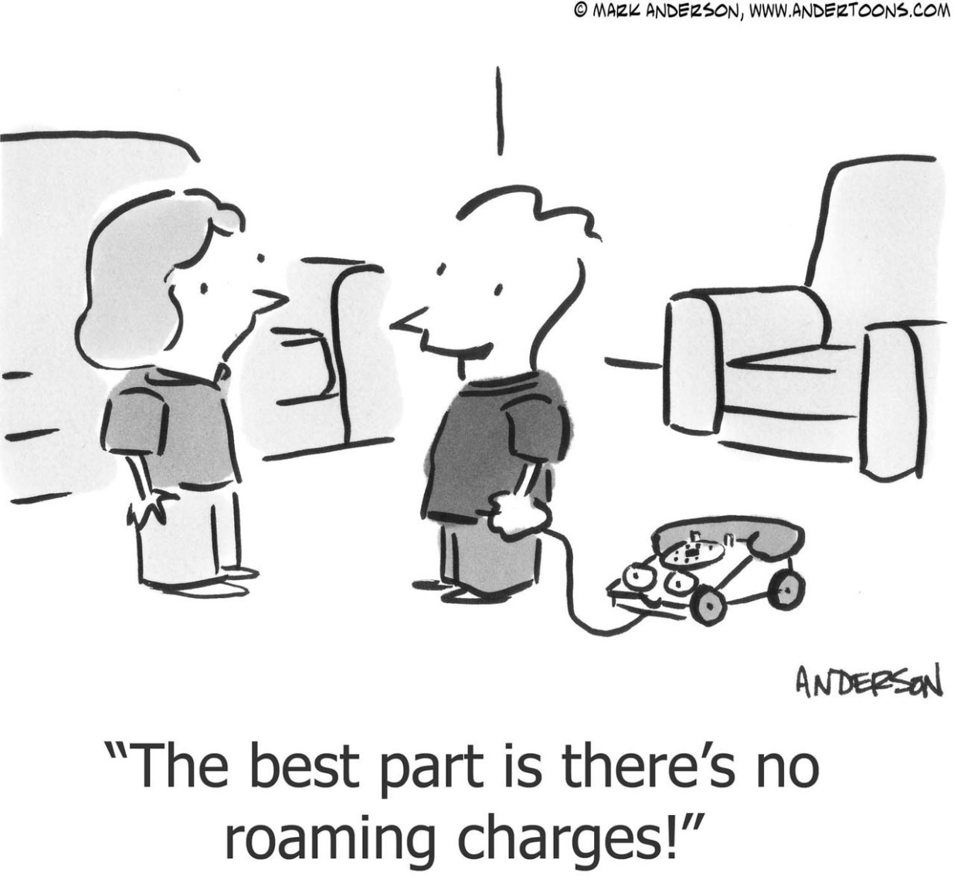
Mobile Access

Slide 4

SC2008/CZ3006/CE3005 ​ Computer Network
Lecture 9
Mobile Access Networks:
From 1G to 5G
(Not Examinable)

Slide 5
Contents
Wireless Link Standards
802.11 (Wi-Fi)
Cellular (1G to 5G)
802.15 (e.g., ZigBee)
802.16 (WiMax)
Cellular Networks
Network architecture
MAC protocols
1G to 5G
Mobility handling
Mobility vocabulary
Indirect routing
Direct routing

Slide 6
Wireless Link Standards

Slide 7
Characteristics of Selected Wireless Link Standards
200
802.11n
54
802.11a,g
802.11a,g point-to-point
data
5-11
802.11b
802.16 (WiMAX)
4
Data rate (Mbps)
1
802.15
.384
UMTS/WCDMA, CDMA2000
3G
.056
IS-95, CDMA, GSM
2G
Indoor
10-30m
Outdoor
50-200m
Mid-range
outdoor
200m – 4 Km
Long-range
outdoor
5Km – 20 Km

Slide 8

Characteristics of Selected Wireless Link Standards
200
802.11n
54
802.11a,g
802.11a,g point-to-point
data
5-11
802.11b
802.16 (WiMAX)
4
Data rate (Mbps)
1
802.15
.384
UMTS/WCDMA, CDMA2000
3G
.056
IS-95, CDMA, GSM
2G
Indoor
10-30m
Outdoor
50-200m
Mid-range
outdoor
200m – 4 Km
Long-range
outdoor
5Km – 20 Km

Slide 9
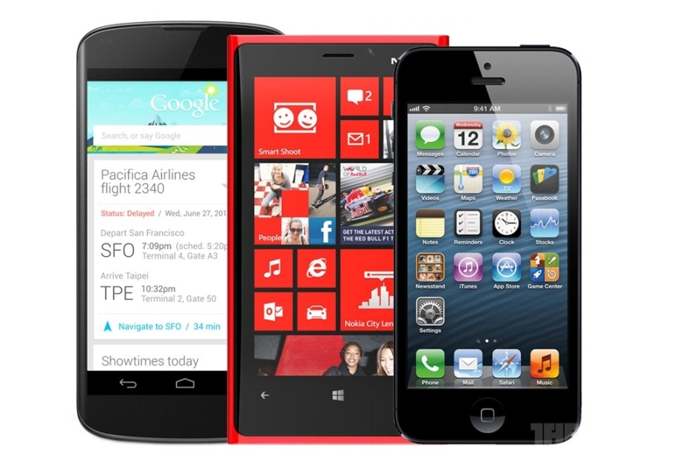
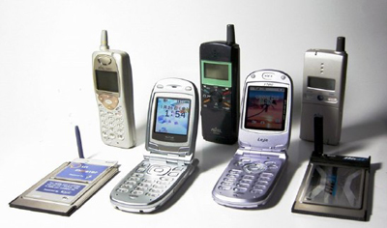
Characteristics of Selected Wireless Link Standards
200
802.11n
54
802.11a,g
802.11a,g point-to-point
data
5-11
802.11b
802.16 (WiMAX)
4
Data rate (Mbps)
1
802.15
.384
UMTS/WCDMA, CDMA2000
3G
.056
IS-95, CDMA, GSM
2G
Indoor
10-30m
Outdoor
50-200m
Mid-range
outdoor
200m – 4 Km
Long-range
outdoor
5Km – 20 Km

Slide 10
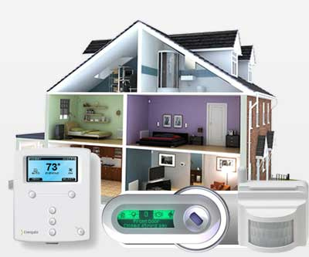
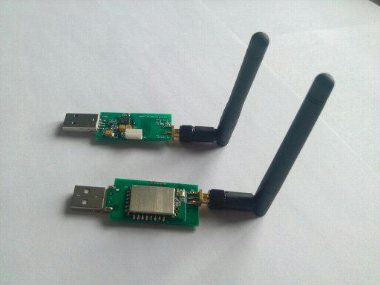
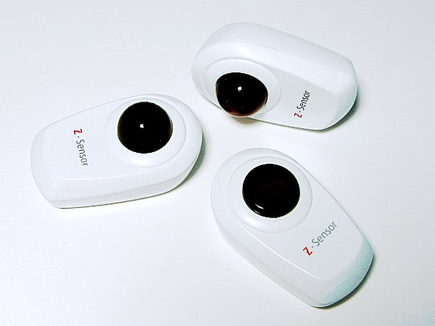
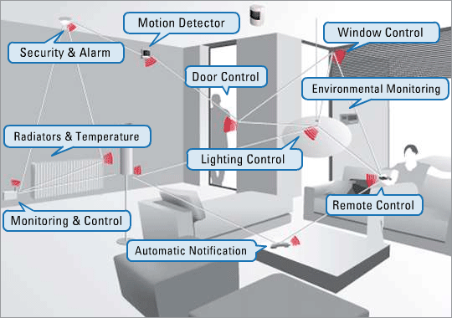
Characteristics of Selected Wireless Link Standards
200
802.11n
54
802.11a,g
802.11a,g point-to-point
data
5-11
802.11b
802.16 (WiMAX)
4
Data rate (Mbps)
1
802.15
Zigbee
.384
UMTS/WCDMA, CDMA2000
3G
.056
IS-95, CDMA, GSM
2G
Indoor
10-30m
Outdoor
50-200m
Mid-range
outdoor
200m – 4 Km
Long-range
outdoor
5Km – 20 Km

Slide 11
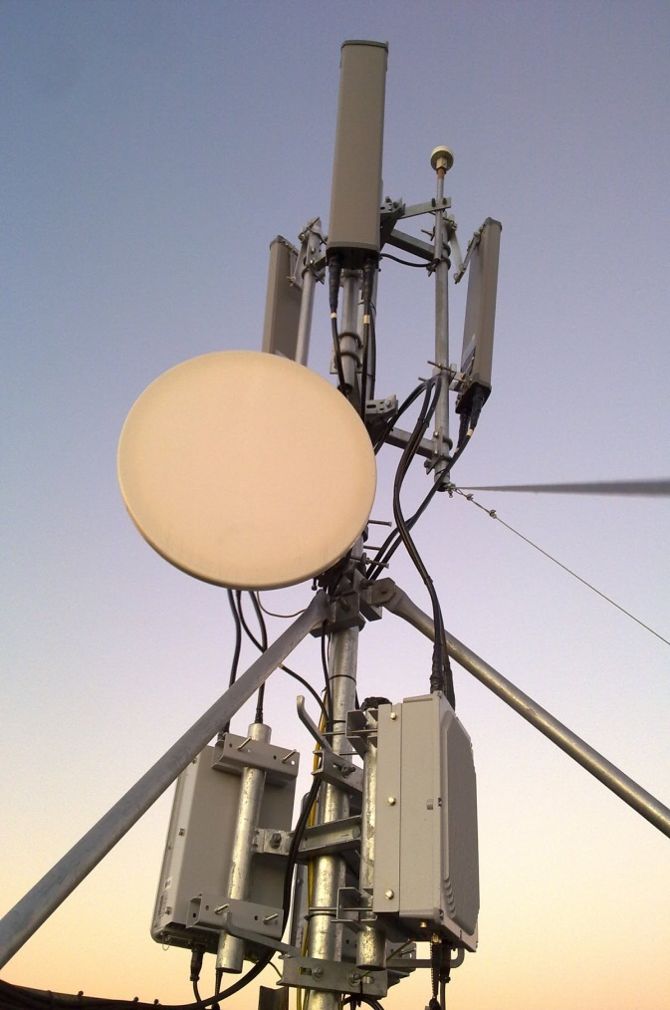
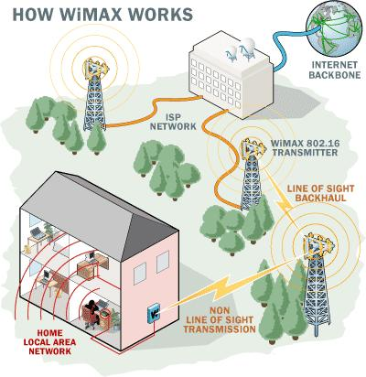
Characteristics of Selected Wireless Link Standards
200
802.11n
54
802.11a,g
802.11a,g point-to-point
data
5-11
802.11b
802.16 (WiMAX)
4
Data rate (Mbps)
1
802.15
.384
UMTS/WCDMA, CDMA2000
3G
.056
IS-95, CDMA, GSM
2G
Indoor
10-30m
Outdoor
50-200m
Mid-range
outdoor
200m – 4 Km
Long-range
outdoor
5Km – 20 Km

Slide 12
Cellular Networks: 1G to 5G

Slide 13
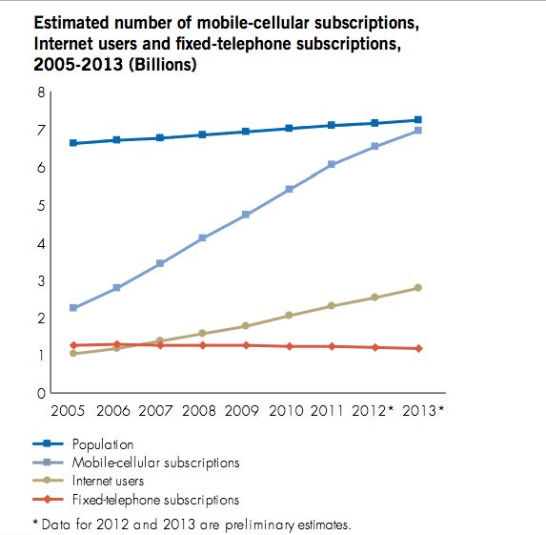
Boost of Mobiles

Slide 14


Cellular Network Architecture
MSC
connects cells to wide area net
manages call setup
handles mobility
cell
covers geographical region
base station (BS) similar to 802.11 AP
mobile users attach to network through BS
air-interface: physical and link layer protocol between mobile and BS
Mobile
Switching
Center
Public telephone
network, and
Internet
Mobile
Switching
Center
wired network

Slide 15

Interconnection of Cellular Networks
correspondent
wired public telephone
network
MSC
MSC
MSC
MSC
MSC
different cellular networks,
operated by different providers

Slide 16
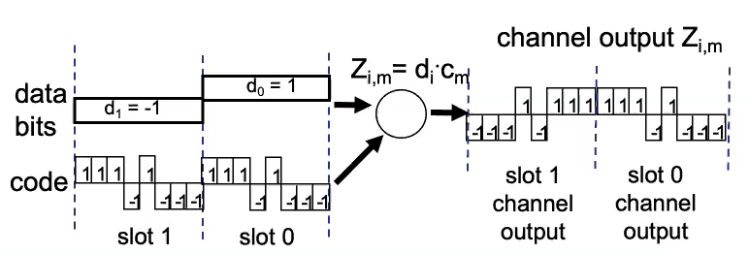
Cellular Network: The First Hop
Two techniques for sharing mobile-to-BS radio spectrum
Combined FDMA/TDMA: divide spectrum in frequency channels, divide each channel into time slots
CDMA: code division multiple access
time slots
frequency
bands

Slide 17
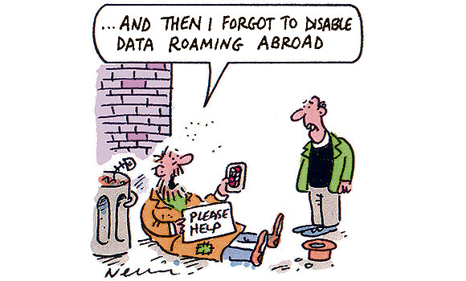
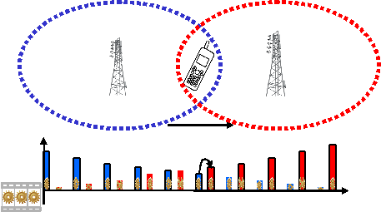
Handover and Roaming
Handover: transfer a call or data session from one cell to another within the same cellular network
Handled by Mobile Switching Center (MSC), no charge
Roaming: the mobile moves from its home cellular network to a foreign network
Handover
Roaming

Slide 18
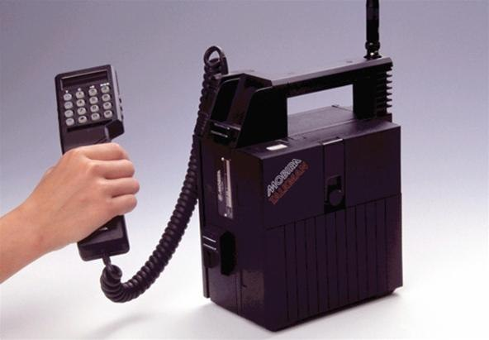
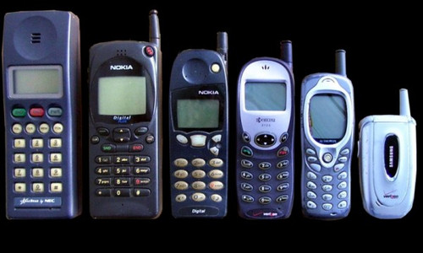
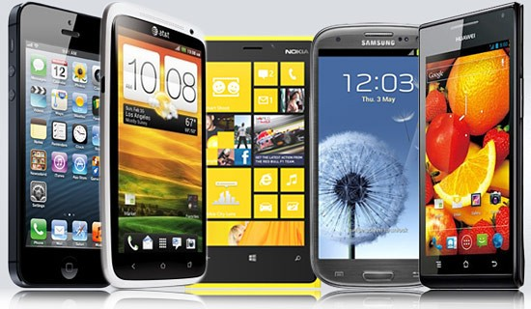
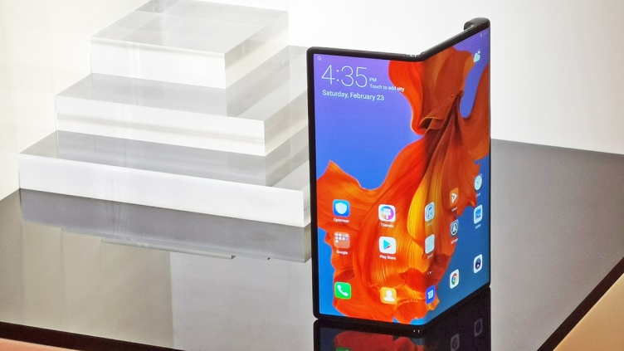
Cellular Standards: Brief Survey
1G: analog, 3 decades ago
2G/2.5G: 50-384kbps, 2 decades ago
3G: up to 14Mbps
4G: up to 300Mbps
Last decade
5G: up to 430Mbps using sub-6GHz
up to 10Gbps using >24GHz
From 2019

Slide 19
Cellular Standards: Brief Survey
2G systems: voice channels
IS-136 TMDA: combined FDMA/TDMA (North America)
GSM (global system for mobile communications): combined FDMA/TDMA
Most widely deployed
IS-95 CDMA: code division multiple access
CDMA-2000
TDMA/FDMA
GPRS
EDGE
UMTS
IS-136
GSM
IS-95
Don’t drown in a bowl of alphabet soup: use this for reference only

Slide 20
Cellular Standards: Brief Survey
2.5G systems: voice and data channels
2G extensions: for those who can’t wait for 3G
General packet radio service (GPRS)
Evolved from GSM
Data sent on multiple channels (if available)
Enhanced data rates for global evolution (EDGE)
Also evolved from GSM, using enhanced modulation
Data rates up to 384kbps
CDMA-2000 (phase 1)
Data rates up to 144kbps
Evolved from IS-95

Slide 21
2G (voice) Network Architecture
Base station system (BSS)
MSC
BTS
BSC
G
Public switched
telephone
network
Gateway
MSC
Legend
Base transceiver station (BTS)
Base station controller (BSC)
Mobile Switching Center (MSC)
Mobile subscribers

Slide 22
2.5G (Voice+Data) Network Architecture
MSC
BSC
G
Public switched
telephone
network
Gateway
MSC
G
Public
Internet
Key insight: new cellular data
network operates in parallel
with existing cellular voice network
voice network unchanged in core
data network operates in parallel
SGSN
GGSN
Serving GPRS Support Node (SGSN)
Gateway GPRS Support Node (GGSN)

Slide 23
Cellular Standards: Brief Survey
3G systems: voice + data
Universal Mobile Telecommunications Service (UMTS)
CDMA in TDMA slots
Data service: up to 14 Mbps
4G systems: data
All-IP network: voice in data packets
New wireless access technologies: OFDM, MIMO, etc
Data rate: up to 300 Mbps

Slide 24
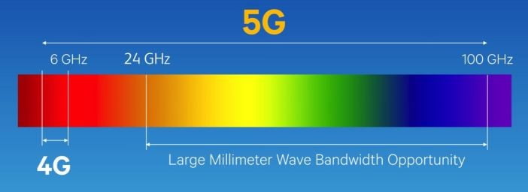
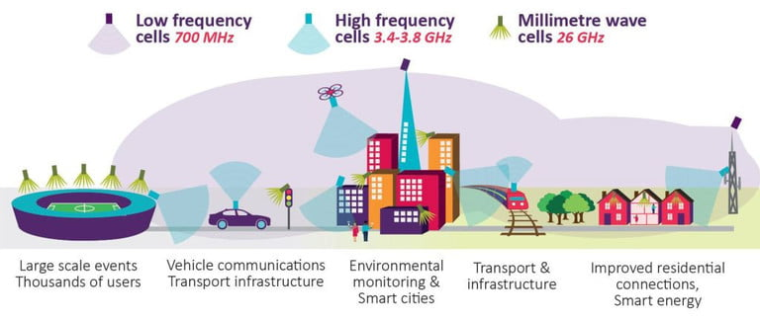
Cellular Standards: Brief Survey
5G systems: massive data
Microwaves (4G) + millimeter waves (high bandwidth)

Slide 25
Mobility (Roaming) Handling

Slide 26
What Is Mobility?
Spectrum of mobility, from the network perspective:
no mobility
high mobility
mobile wireless user,
using same point of access
mobile user, connecting/ disconnecting from network using DHCP.
mobile user, passing through multiple points of access while maintaining ongoing connections (like cell phone)

Slide 27



Mobility: Vocabulary
home network: permanent “home” of mobile
(e.g., 128.119.40/24)
home agent: entity that will perform mobility functions on behalf of mobile, when mobile is remote
wide area network
Permanent address: address in home network, can always be used to reach mobile
e.g., 128.119.40.186
correspondent

Slide 28
Mobility: Vocabulary
visited network: network in which mobile currently resides (e.g., 79.129.13/24)
Permanent address: remains constant (e.g., 128.119.40.186)
Care-of-address: address in visited network.
(e.g., 79,129.13.2)
wide area network
foreign agent: entity in visited network that performs mobility functions on behalf of mobile.
correspondent: wants to communicate with mobile

Slide 29
Mobility: Approaches
Let routing handle it: routers advertise permanent address of mobile-nodes-in-residence via usual routing table exchange
Routing tables indicate where each mobile located
No changes to end-systems
Let end-systems handle it:
Indirect routing: communication from correspondent to mobile goes through home agent, then forwarded to remote
Direct routing: correspondent gets foreign address of mobile, sends directly to mobile

Slide 30
Mobility: Approaches
Let routing handle it: routers advertise permanent address of mobile-nodes-in-residence via usual routing table exchange
Routing tables indicate where each mobile located
No changes to end-systems
Let end-systems handle it:
Indirect routing: communication from correspondent to mobile goes through home agent, then forwarded to remote
Direct routing: correspondent gets foreign address of mobile, sends directly to mobile
not
scalable
to millions of
mobiles

Slide 31
Mobility: Registration
visited network
home network
1
2
wide area network
mobile contacts foreign agent on entering visited network
foreign agent contacts home agent: “this mobile is resident in my network”
End result:
Foreign agent knows about mobile
Home agent knows location of mobile

Slide 32
Mobility via Indirect Routing
foreign agent receives packets, forwards to mobile
home agent intercepts packets, forwards to foreign agent
visited
network
home
network
3
wide area network
2
1
correspondent addresses packets using home address of mobile
4
mobile replies directly to correspondent

Slide 33
Indirect Routing: Comments
Mobile uses two addresses
Permanent address: used by correspondent (hence mobile location is transparent to correspondent)
Care-of-address (Foreign address): used by home agent to forward datagrams to mobile
Triangle routing: correspondent-home network-mobile
Inefficient when correspondent & mobile are in same network

Slide 34
Indirect Routing: Moving Between Networks
Suppose mobile user moves to another network
Register with new foreign agent
New foreign agent registers with home agent
Home agent update care-of-address for mobile
Packets continue to be forwarded to mobile (but with new care-of-address)
Mobility, changing foreign networks
Transparent: ongoing connections can be maintained!

Slide 35
Mobility via Direct Routing
foreign agent receives packets, forwards to mobile
correspondent forwards to foreign agent
visited
network
home
network
4
wide area network
2
3
correspondent requests, receives foreign address of mobile
1
4
mobile replies directly to correspondent

Slide 36
Mobility via Direct Routing: Comments
Overcome triangle routing problem
Non-transparent to correspondent: correspondent must get care-of-address from home agent
What if mobile changes visited network?

Slide 37
Accommodating Mobility with Direct Routing
Anchor foreign agent: FA in first visited network
Data always routed first to anchor FA
When mobile moves: new FA arranges to have data forwarded from old FA (chaining)
foreign net visited
at session start
anchor
foreign
agent
wide area network
2
1
4
5
3
new
foreign
network
correspondent
agent
new foreign
agent
correspondent

Slide 38
Handling Mobility in Cellular Networks
Home network: network of cellular provider you subscribe to (e.g., SingTel, M1)
Home location register (HLR): database in home network containing permanent cell phone #, profile information (services, preferences, billing), information about current location (could be in another network)
Visited network: network in which mobile currently resides
Visitor location register (VLR): database with entry for each user currently in network
Could be home network

Slide 39

GSM: Indirect Routing to Mobile
HLR
home
network
2
correspondent
home
Mobile
Switching
Center
home MSC consults HLR,
gets roaming number of
mobile in visited network
1
call routed
to home network
3
Public switched
telephone
network
VLR
Mobile
Switching
Center
4
home MSC sets up 2nd leg of call
to MSC in visited network
mobile
user
MSC in visited network completes
call through base station to mobile
visited
network

Slide 40
Wireless, Mobility: Impact on Higher Layer Protocols
Logically, impact should be minimal …
Best effort service model remains unchanged
Higher layers can (and do) run over wireless, mobile
… but performance-wise
Packet loss/delay due to bit-errors (discarded packets, delays for link-layer retransmissions), and handoff
Delay impairments for real-time traffic
Limited bandwidth of wireless links

Slide 41
Learning Objectives
Wireless Link Standards
Read the characteristics of the standards
Cellular Networks
Understand the network architecture
Understand the key features of 1G to 5G
Mobility (roaming) handling
Read mobility vocabulary
Understand indirect and direct routing

